Slide 1
Lead Scoring Case Study for X - education company
Anand Singh Bhandari
Anish Gautam
Kushagra Rao

Slide 2
CONTENTS
Introduction
Problem Statement
Assumptions
Approach and Methodology
Areas Of Focus – Graphs and Insights
Model Summary

Slide 3
INTRODUCTION

Slide 4
An education company named X Education sells online courses to industry professionals. The company markets its courses on their website, several other websites and search engines like Google.
When people fill up a form providing their email address or phone number, they are classified to be a lead. Moreover, the company also gets leads through past referrals.
Although X Education gets a lot of leads, its lead conversion rate is very poor around 30%.

Slide 5
Problem statement

Slide 6
To make conversion rate more efficient, the company wishes to identify the most potential leads, also known as ‘Hot Leads’.
If the company successfully identify this set of leads, the lead conversion rate should go up as the sales team will now be focusing more on communicating with the potential leads rather than making calls to everyone.
Need to find out most promising leads that are most likely to convert into paying customers. The company requires you to build a model wherein you need to assign a lead score to each of the leads such that the customers with a higher lead score have a higher conversion chance and the customers with a lower lead score have a lower conversion chance.
The CEO has given a ballpark of the target lead conversion rate to be around 80%.

Slide 7
ASSUMPTIONS

Slide 8
Assumptions based on Linear regression model:
Linearity: We assume that there is a linear relationship between the independent variables (such as TotalVisits, Total Time Spent on Website, Page Views Per Visit) and the dependent variable (Converted). This can be examined by plotting scatterplots of each independent variable against the dependent variable.
Homoscedasticity: We assume that the variance of the errors is constant across all levels of the independent variables. This means that the spread of the residuals should be roughly the same for different values of the independent variables.
Normality of errors: We assume that the errors follow a normal distribution. This assumption is important for hypothesis testing and confidence interval estimation. We can check this assumption by examining a histogram or Q-Q plot of the residuals.
No multicollinearity: We assume that there is no high correlation between independent variables. Multicollinearity can inflate the standard errors of the coefficients and make the estimates unstable. We can assess multicollinearity by calculating the correlation matrix or variance inflation factors (VIF) for the independent variables.
Correct specification of the model: We assume that the model includes all relevant independent variables and excludes irrelevant ones. This assumption ensures that the model adequately captures the relationship between the independent and dependent variables.

Slide 9
APPROACH & Methodology

Slide 10
Data Sanity, Data Cleaning and Correlation
Browse through the data dictionary and understanding the domain / variables.
Import / Load the data sets
Check the shape, info, column names, data types of the data set, check for null, empty, missing values
Drop columns where missing value is greater than 30-40%
Drop columns than have high proportions of ‘Select’ since they are same as null
Create dummy features wherever applicable for categorical variables
Impute / remove missing values and standardize the values where needed
Check for outliers and skew them if needed
Perform univariate analysis
Perform bivariate analysis
Scaling Feature
Feature Selection
Model Building
Model Evaluation
Model Prediction
Model Summary

Slide 11
Graphs & INSIGHTS

Slide 12
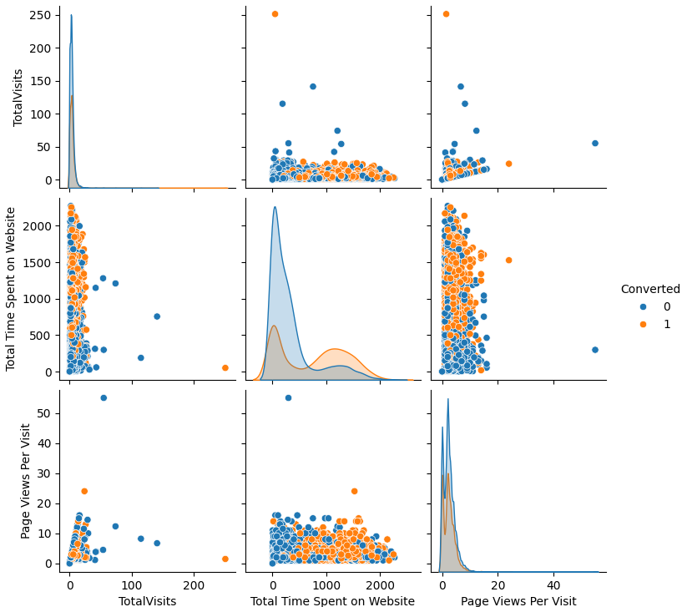
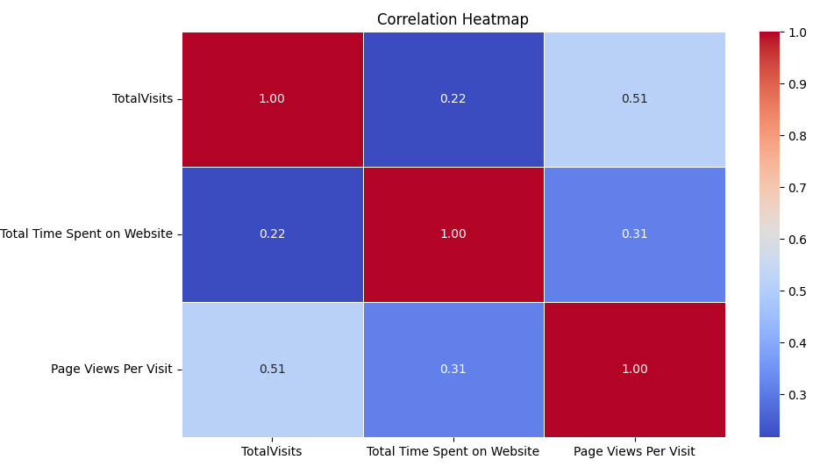


Numerical - Pair Plot & Correlation

Slide 13
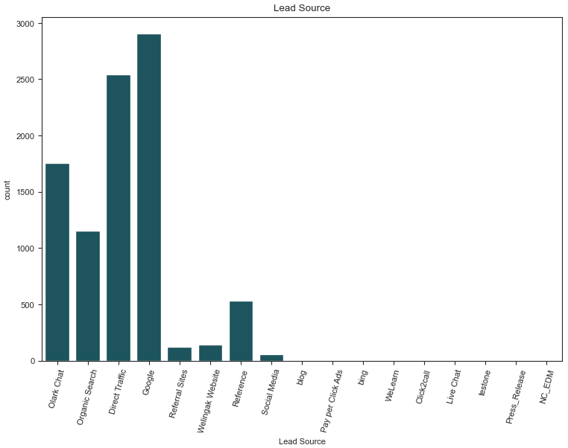
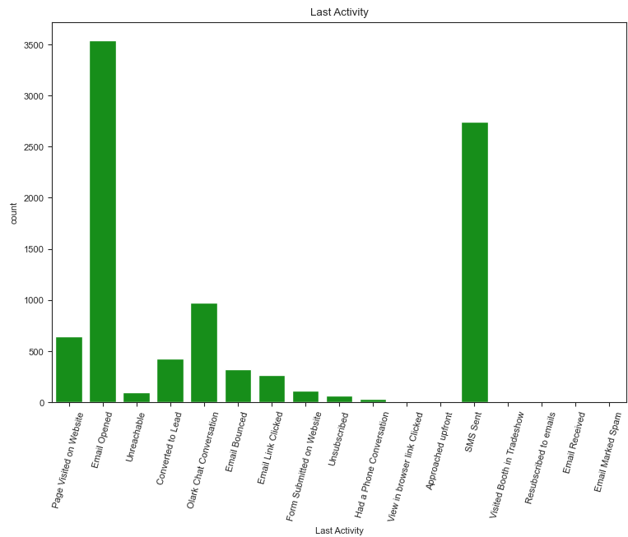
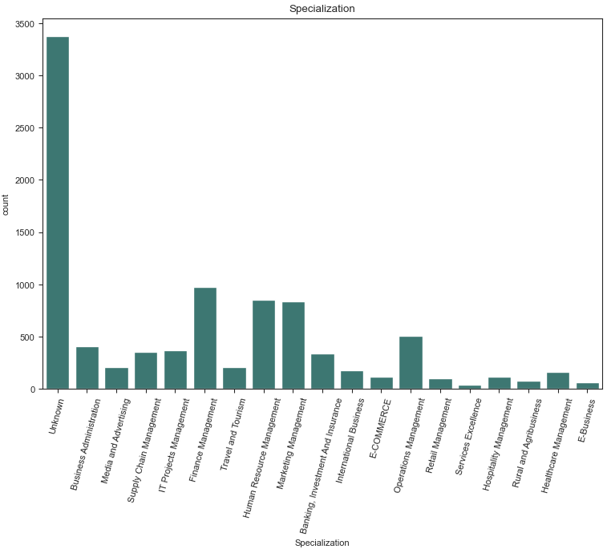
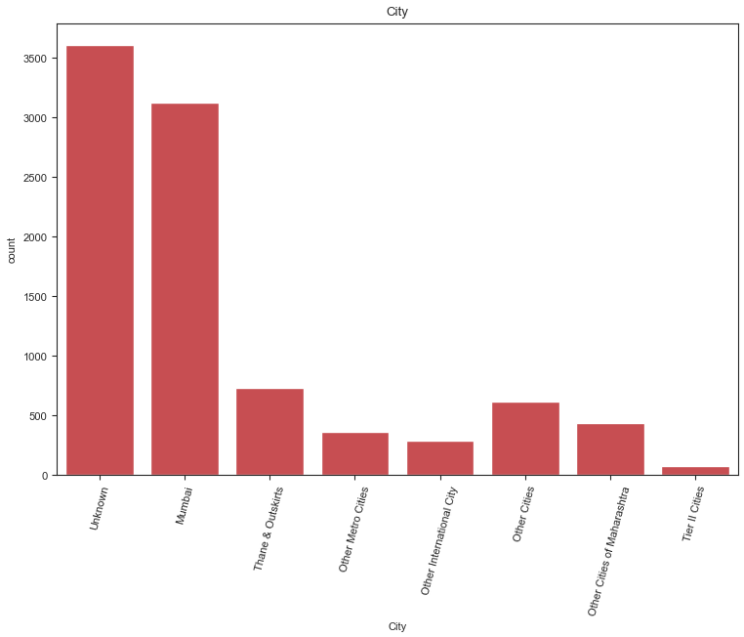
Univariate- Categorical
Highest Lead Source is Google.
Email opened last activity shows the highest count
Finance Management specialisation has the highest count
Mumbai City has the highest count

Slide 14
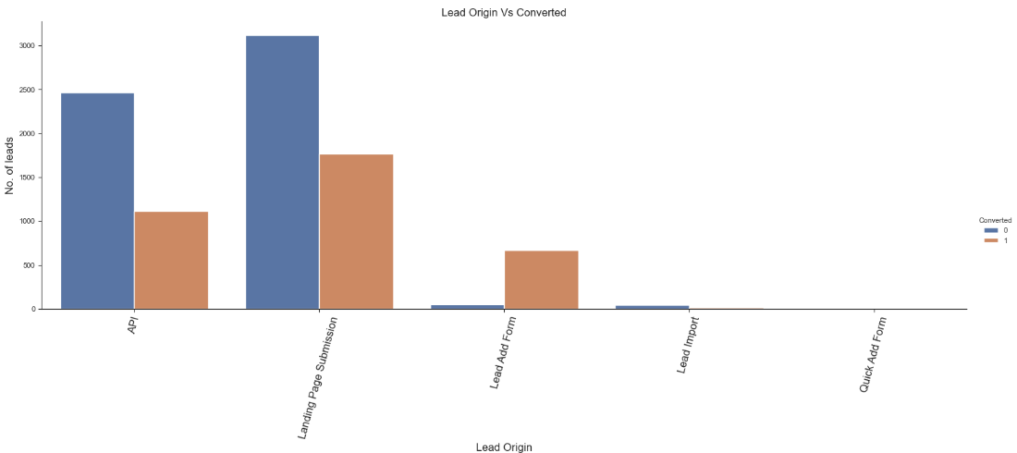
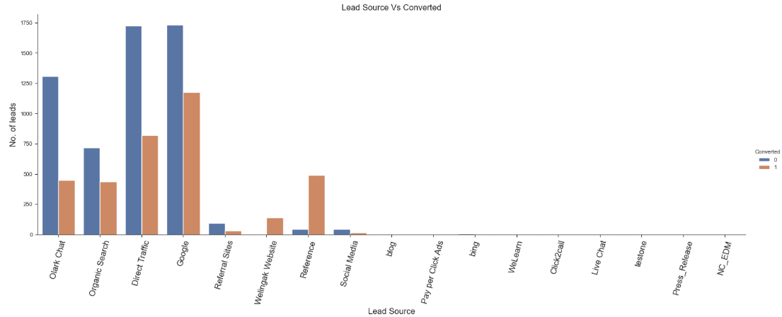
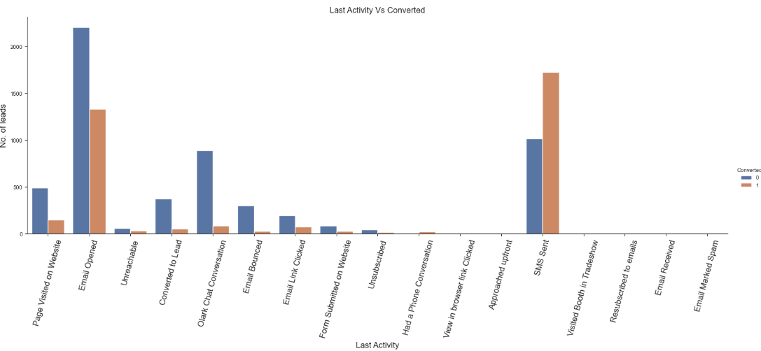
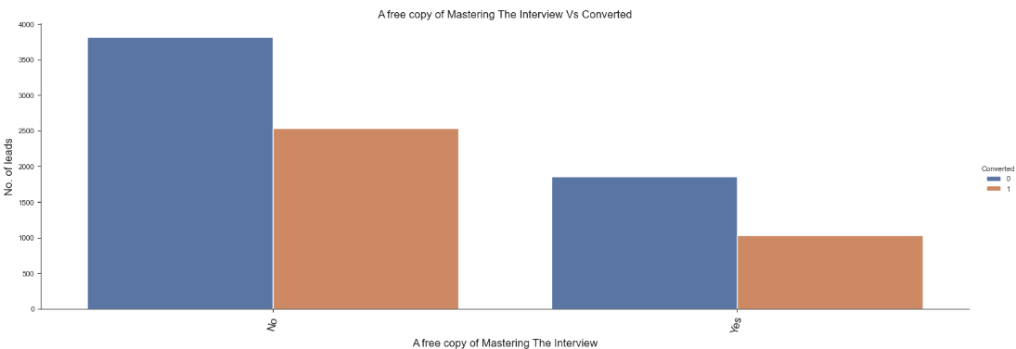
Category wise conversation Rate

Slide 15
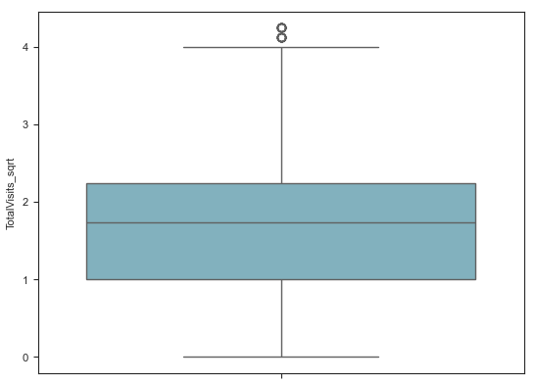
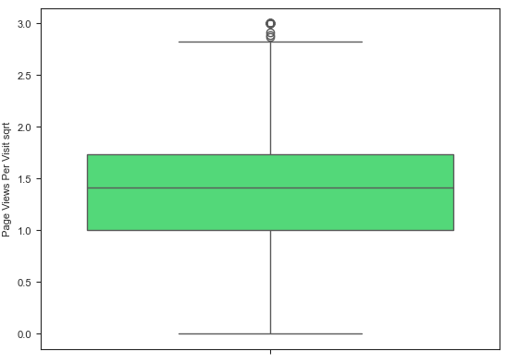
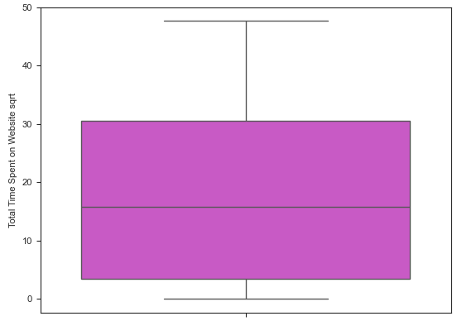
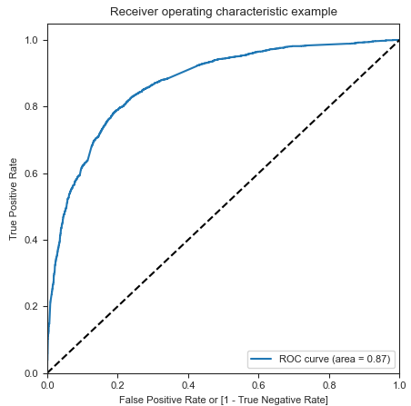
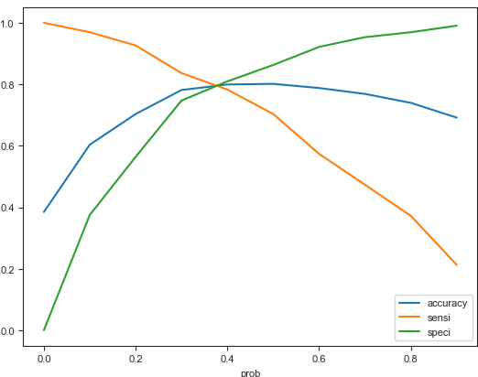
Outlier analysis
ROC Curve
‘accu’,'sensi','speci’Plot

Slide 16
Summary

Slide 17
Here is a summary of the linear regression model:
Overall Accuracy: The overall accuracy of the linear regression model on the test set is approximately 80.77%. This indicates that the model correctly predicts the lead conversion outcome for about 80.77% of the observations in the test set.
Sensitivity: The sensitivity of the model, also known as the true positive rate or recall, is approximately 80.54%. This means that the model correctly identifies about 80.54% of the actual positive cases (i.e., leads that were converted).
Specificity: The specificity of the model, which is the true negative rate, is approximately 80.92%. This implies that the model correctly identifies about 80.92% of the actual negative cases (i.e., leads that were not converted).
AUC-ROC value of 0.87 suggests that the model has good discriminative power and predictive capability, making it useful for binary classification tasks. The model's predictions are generally reliable, with a high probability of assigning higher scores to positive instances compared to negative instances.

Slide 18
THANK YOU

